Slide 1
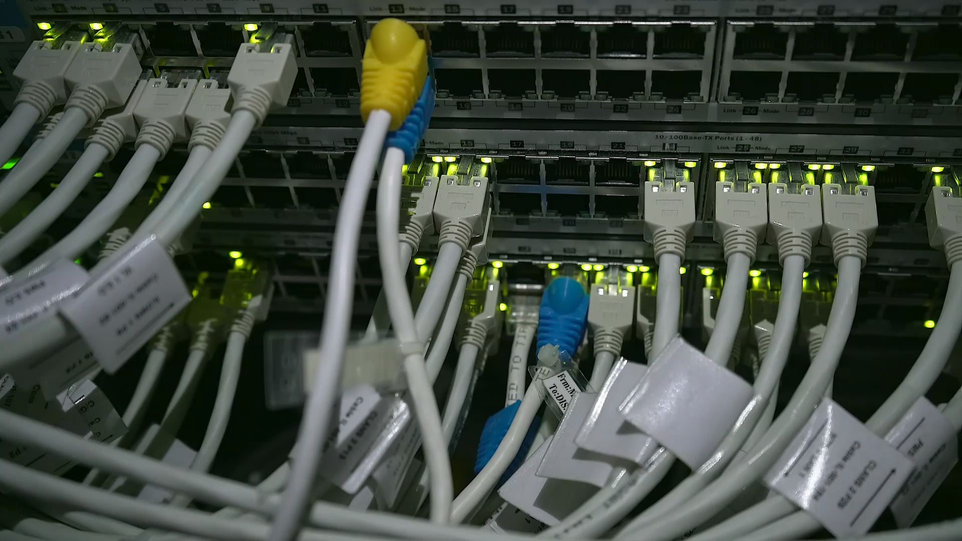
Capturing Network Traffic with Pktmon and Analyzing it in Wireshark
A Step-by-Step Guide

Slide 2
What is packet capture
Logs all traffic that flows in and out of a machine
Useful diagnostic tool when something is not working
Wireshark is the most common tool

Slide 3
What is Pktmon?
Pktmon (Packet Monitor) is a built-in Windows network diagnostics tool.
Introduced in Windows 10 2004 update.
Installed on Server 2019 and later
Can capture, filter, and log network traffic.
Reduces the need to install and patch Wireshark when packet capture is needed

Slide 4
Basic Traffic capture with Pktmon
Open
Open Command Prompt as Administrator.
Change
Change to the folder you want to use to store the capture
Logging
Start logging: pktmon start –c
Reproduce
Reproduce the issue
Validate
Validate capture by running pktmon counters
Logging
Stop logging: pktmon stop
Output
Output saved as .etl file in current directory.

Slide 5
Converting .etl to .pcapng or txt
Use the command: pktmon etl2pcapng pktmon.etl
File is created in current directory and can be sent to network or middleware for analysis
Use the command: pktmon etl2txt pktmon.etl
File can be opened in a text editor

Slide 6
Opening in Wireshark
Open Wireshark.
Load the .pcapng file: File > Open > Select pktmon.pcapng
Analyze traffic using filters and protocol analyzers
Example filters: ip.addr == 192.168.1.1, tcp.port == 80

Slide 7

Enhancing capture
By default, only the first 128 bytes captured, Entire packet log using the command: pktmon start –c --pkt-size 0
Analyzing all the data is like drinking from a fire hose
Filters allow focus on what is needed
Multiple filters can be added
If a filer is not needed, you will need to clear and start over
Specifying a nic may improve results

Slide 8
Filtering before capture
Filter created by pktmon filter add then a paramater as follows:
–t ICMP (TCP, UDP or protocol number)
-I 10.0.45.10 or 10.0.45.0/24 for IP or subnet
-p 443 or –p 80 443 for ports
Pktmon filter remove to clear

Slide 9
Selecting only one nic
pktmon list will show all present nics
Add –comp (ID number) to the end of the command to specify a nic
e.g. pktmon start -c --comp 15
Allows more focus

Slide 10
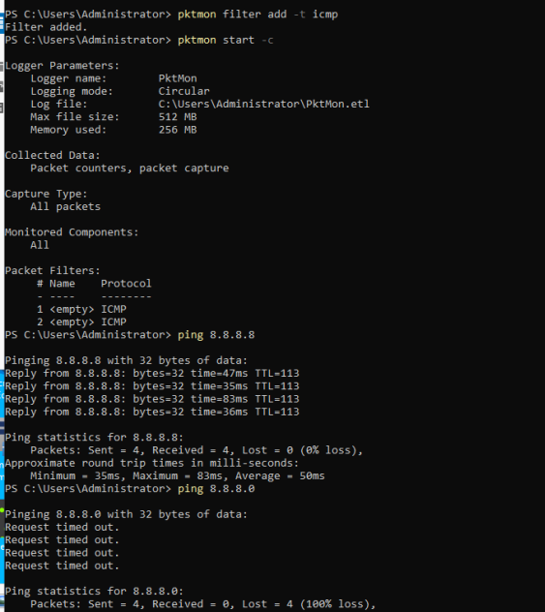
Example

Slide 11
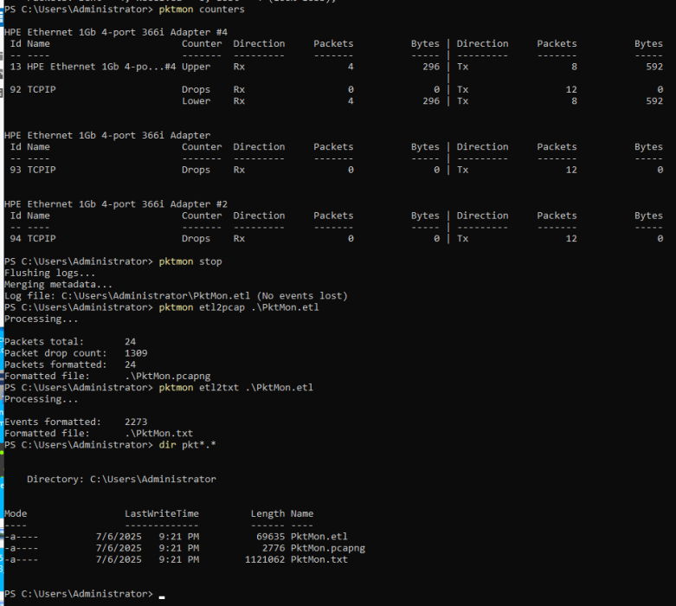
Example (2)

Slide 12
Log Output

Slide 13
Demo
Capture all ICMP traffic
Ping 8.8.8.8 and 8.8.8.0
Convert output to txt
Show the log

Slide 14
Final notes
You may see retransmits if you don’t specify a NIC, those can be ignored
Specify the NIC for a cleaner output
Read the pktmon page for more details about how to use this tool.
This tool is not as robust as wireshark, we may still need wireshark in some cases

Slide 15
Summary
Pktmon is a powerful, built-in packet capture tool on Windows.
Easily captures traffic without installing additional software.
Convert captures to .pcapng and analyze them in Wireshark or examine the data as text.
Ideal for troubleshooting and network diagnostics.

Slide 16
Reference Page
Microsoft pktmon: Packet Monitor (Pktmon) | Microsoft Learn
Pktmon filters: Pktmon command formatting | Microsoft Learn

